Slide 1
Südkabel HVDC Cable System Portfolio
Sebastian Ebert, Vice President; Head of Sales, Marketing & Execution

Slide 2
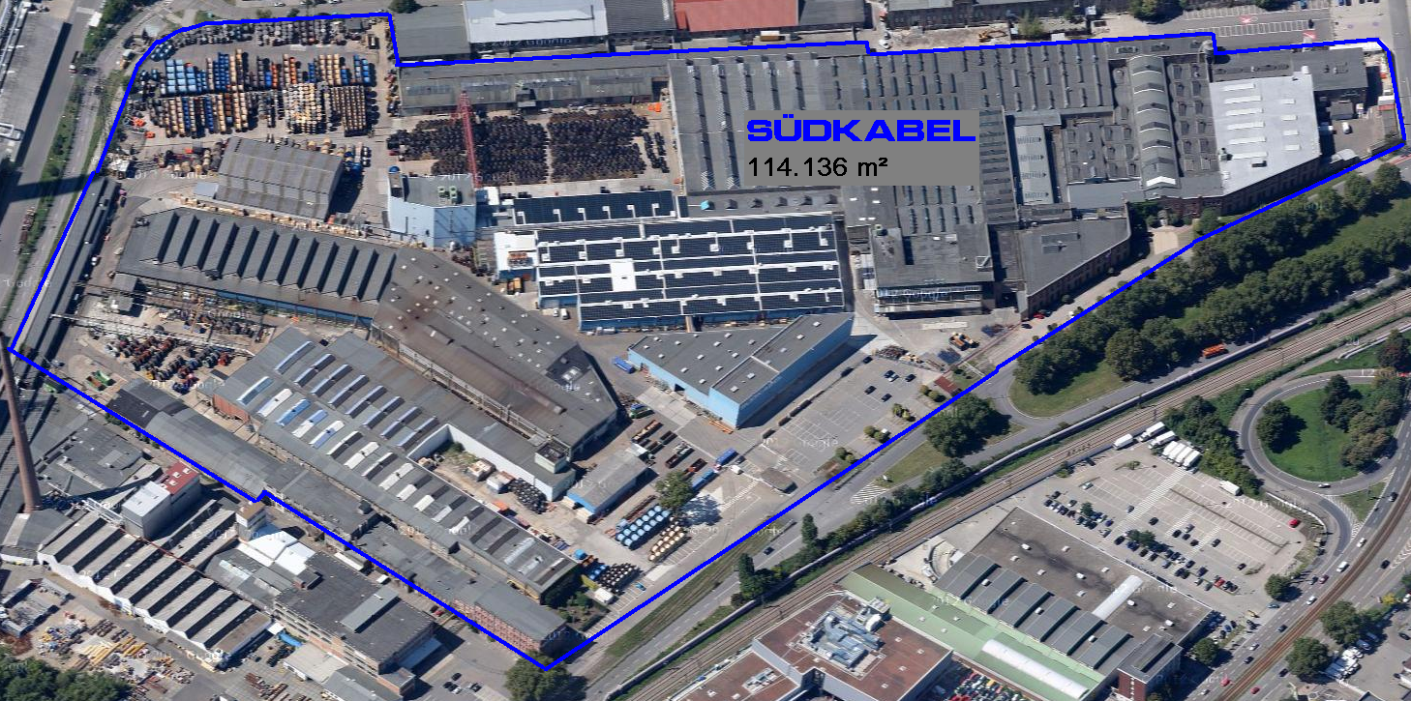
Location

Slide 3
History
Foundation of the Company 1898
Company Names:
Süddeutsche Kabelwerke AG
(SÜDKABEL)
(1898 - 1970)
Kabel und Lackdrahtfabriken GmbH
(1970 - 1988)
ABB Kabel und Draht GmbH
(1988 - 1997)
ABB Energiekabel GmbH
(1997 - 2003)
Südkabel GmbH
(since 2004)

Slide 4
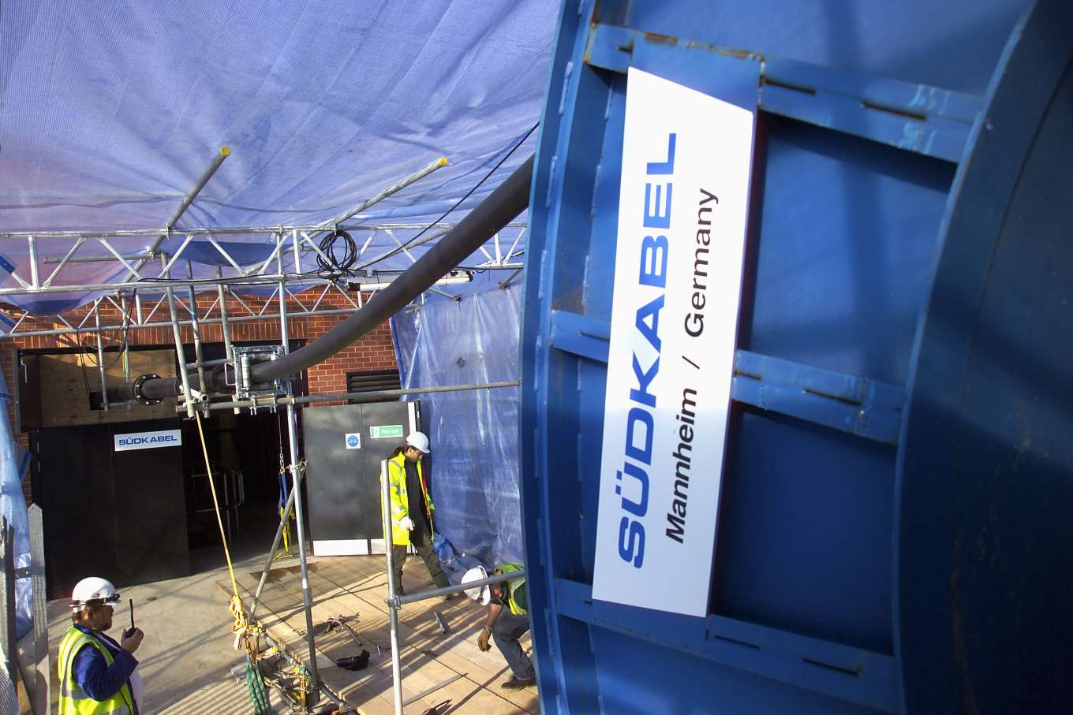
Manufacturing Program and Services
AC XLPE Power Cables for Medium Voltage up to 45 kV
AC XLPE Power Cables for High Voltage up to 245 kV
HV and EHV AC XLPE Cable Systems up to 550 kV
Cable Accessories for AC XLPE Medium Voltage and High Voltage Cables up to 550 kV
Temporary Site Cables (TCS) up to 245 kV
DC XLPE Cable Systems up to 320 kV
Cable Laying and Installation of Accessories
Installation Training and Supervision
On-Site Testing
Calculation & Design
Studies
Seminars

Slide 5
Organization Chart
CEO + Owner
Mr. Johann Erich Wilms
Managing Director
Mr. Dr. Kaumanns
Integrated Management Representative / QM
Mr. Weinlein ^{*)}
Administration
Mr. Dr. Kaumanns
IT Management
Supply Management
Human Resources
Works Council
Mr. Riegler
Cable Production
Mr. Hamberger
Production
Planning
Logistic
Plant Maintenance
Accessory Production
Mr. Bürcky
Production
Planning Logistic
Tec
Development / Testing Mr. Häring
Product Development
AC+DC Systems
HV Test Bays
hnics
Materials / Quality
Mrs. Dr. Nishaburi
Materials
Chemical Laboratories
Quality Assurance
Sales and Execution
Mr. Ebert
Cable Systems Components
Engineering
Installation / Service
Finance
Mr. Baumbauer
Accounting
Controlling
^{*)} provisional

Slide 6
Organization Chart Sales & Execution
Sales & Execution
Mr. Ebert
Cable Systems
Mr. Ebert
HV/EHV Systems
HVDC Systems
Components
Mr. Ebert
MV Accessories
MV Cable
HV/EHV Components
Engineering
Mr. Weinlein System Design System Calculation On-Site Tests
Seminars
Installation / Service
Mr. Bauer
Site Organization New Installation Installation Training
After Sales / Maintenance
Commercial Execution
Mrs. Didion
Commercial Execution
Controlling Projects

Slide 7
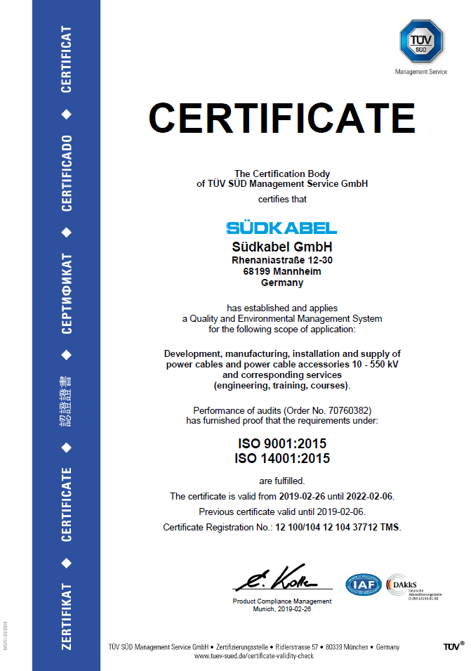
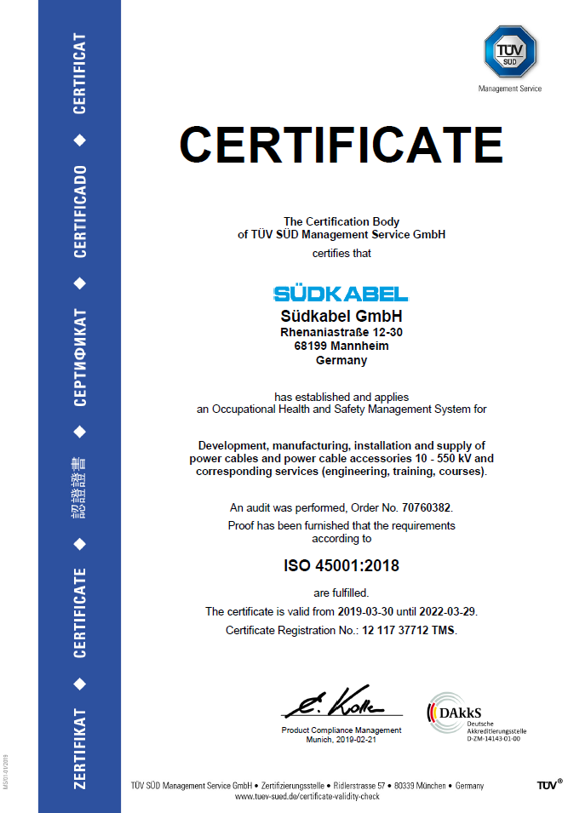
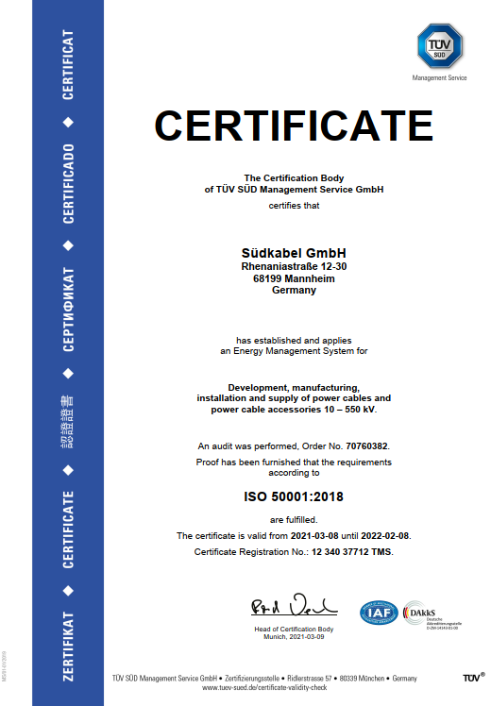
Certified Management Systems ISO 9001, ISO 14001, ISO 45001, ISO 50001

Slide 8
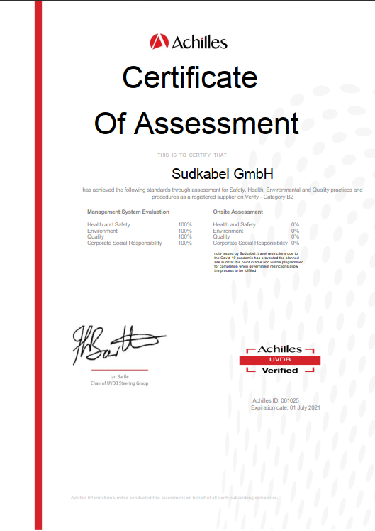
Certification Safety Culture Ladder (SCL), Achilles

Slide 9
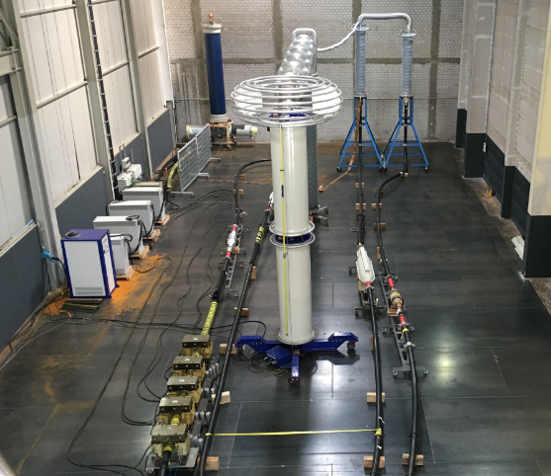
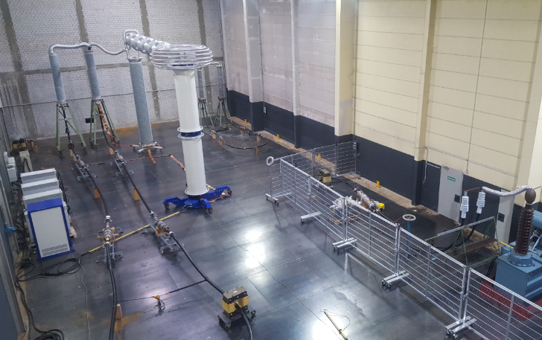
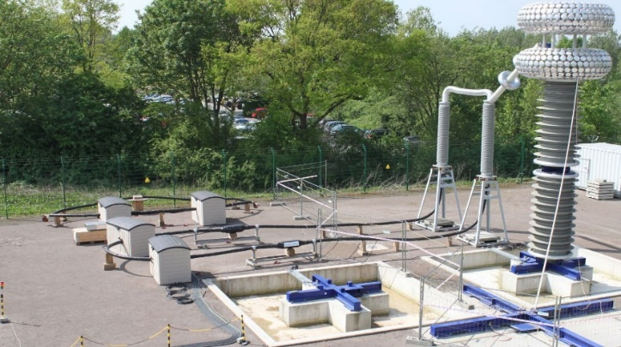
HVDC R&D status
Development and Qualification of HVDC cable systms up to 525 kV
Development of HVDC cable systems up to 525 kV
HVDC cable up to 3200sqmm and 525 kV
Cable accessories designed, tested, and manufactured by Südkabel GmbH in Mannhein, Germany
Qualification of 320 / 525 kV HVDC cable systems
Comprehensive qualification programs on HVDC cable systems acc. to CIGRE, IEC, and DIN IEC standards
Source: TU Dortmund

Slide 10
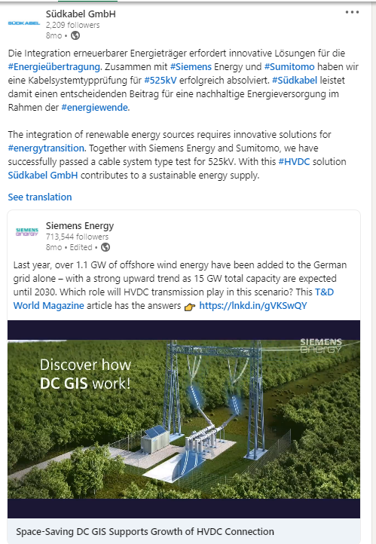
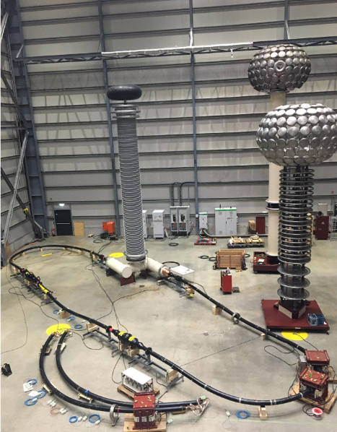
HVDC R&D status
Technology Cooperation with Sumitomo Electric Industries
Technical cooperation within HVDC cable projects up to 525 kV
‘Sumitomo Electric secures >€500M “Corridor A-Nord” High Voltage DC Underground Cable Project in Germany which sets new innovative benchmarks in the HVDC Industry’
Qualification of 525 kV HVDC cable system
Technical collaboration with Siemens Energy within 525 kV HVDC cable system type test
Cables from Sumitomo and Südkabel with Sumitomos advanced DC XLPE
Cable accessories from Sumitomo
DC GIS components provided by Siemens Energy
Successful completion of type test in 2020

Slide 11
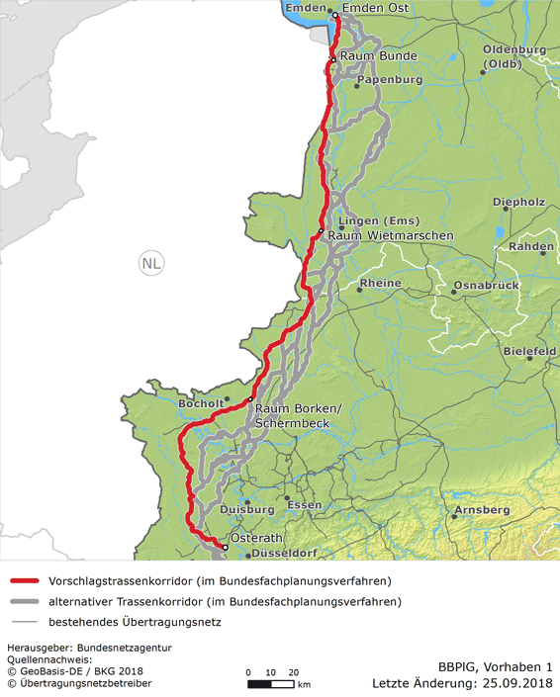
Ongoing Project References
Project: CAN 525 kV Customer: Amprion
Project Scope:
1 HVDC Cable System
Route Lenghts 320 km (+/- Pole)
320 km * 2 = 640 km
In parallel to the HVDC Cable system a metallic return ‘DMR’ cable will be laid.
320 km
Cable Type:
2XS(FL)2Y 1x2500 RMS/188 DC±525 kV
2XS(FL)2Y 1x2500 RMS/188 DMR
Manufacturing: scheduled from 2023 onwards
Commissioning: scheduled 2028
Cable Route Layout

Slide 12
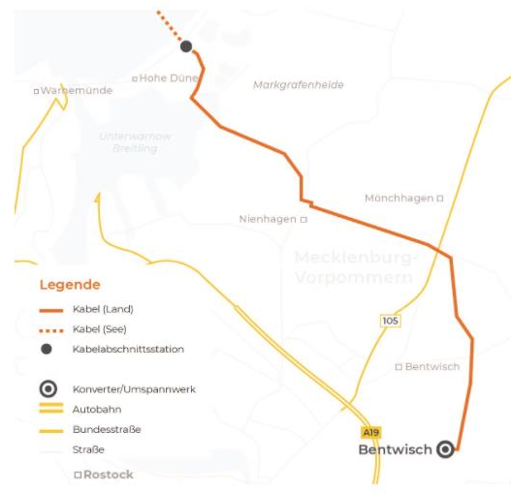
Ongoing Project References
Project: Kontek HVDC Link Customer: 50Hertz
Project Scope:
1 EC Kabelsystem inkl. Garnituren sowie Service und Montage
Cable Type:
A2XS(FL) 1x2200 RMS/50 DC±17,5 kV
Manufacturing: Quarter Q2/2021
Commissioning: scheduled 2022
Cable Route Layout

Slide 13
Thank you for your attention
Contact details for any questions:
Sebastian Ebert
Head of Sales, Marketing & Execution
Telephone: +49 (0) 621 8507 395
Mobil: +49 (0) 173 2598 491
E-Mail: sebastian.ebert@suedkabel.com

